Slide 1

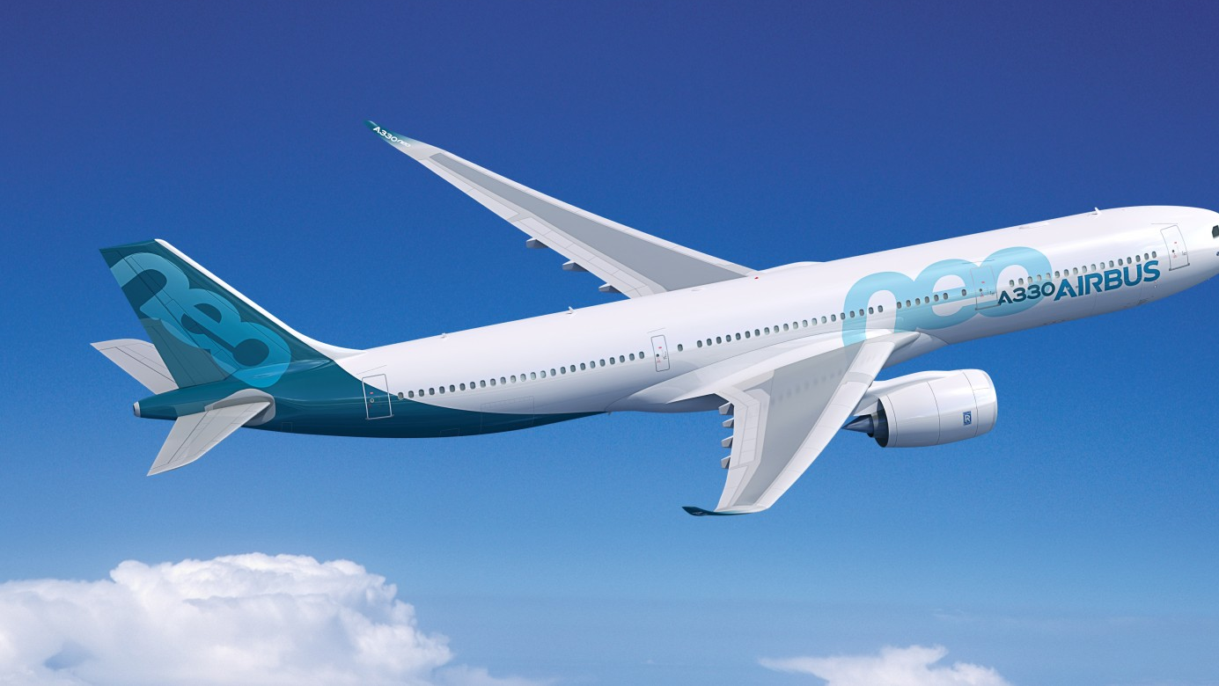
Flying on Empty
Mikołaj Buczak

Slide 2
Air Transat Flight 236
Introduction
Flight Info
Overall Situation
Progression of a flight
Standard Flight Routine
First Problems
Snowball Effect
Situation Finale
Outcome
Investigation
Aftermath

Slide 3






Flight Info
Toronto, Canada
Lisbon, Portugal
Air Transat - Airbus A330
23-24/08/2001
8:52 PM (ET)
306 (293 passengers + 13 crew members)

Slide 4
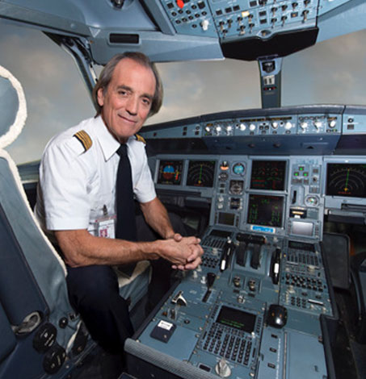
Captain Robert Piché
Age: 48
First officer Dirk de Jager
Age: 28

Slide 5
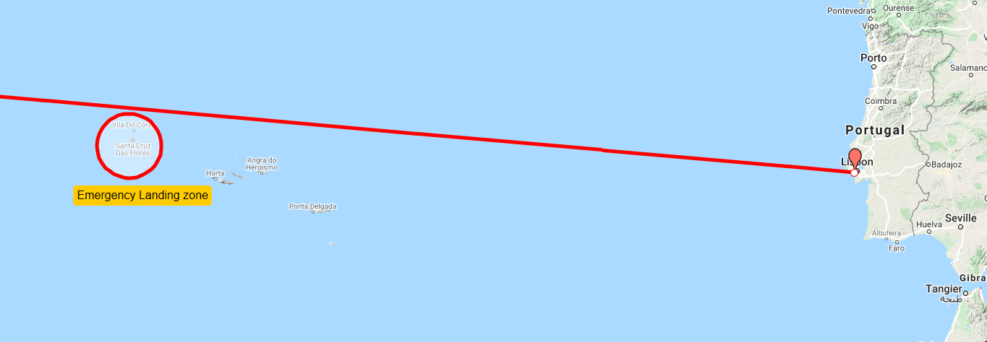
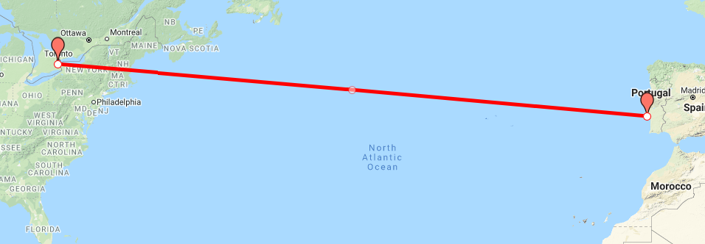
Overall Situation
Landing speed: 200 knots (370 km/h)
Landing run: 2.3 km
Runaway length: 3 km
No victims
2 people seriously injured

Slide 6
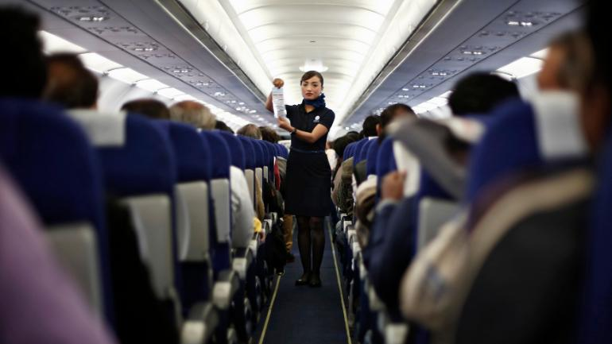
Standard Flight Routine
Take off time: 8:52 PM (ET)
Initial fuel weight: 46.9 t
Route adjustments: 60 miles South
Time flown without any problem: 5 hours

Slide 7
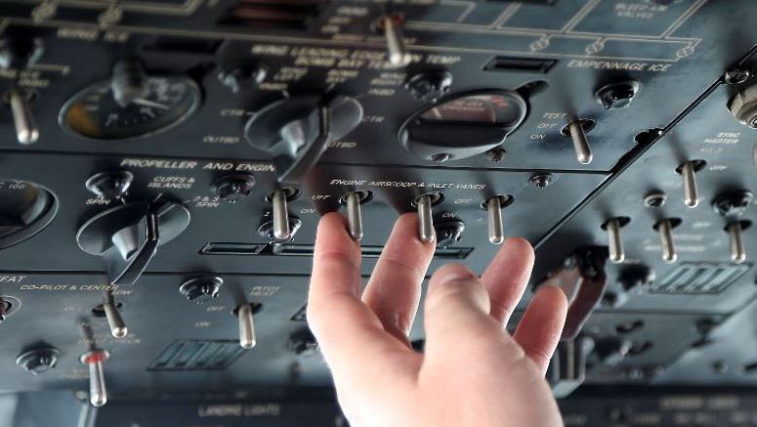
First Problems
Low temperature and high pressure warning
Flight manual gave no information
Control centre advised monitoring oil level
Crew suspected false readings
No other problem for next 30 minutes

Slide 8
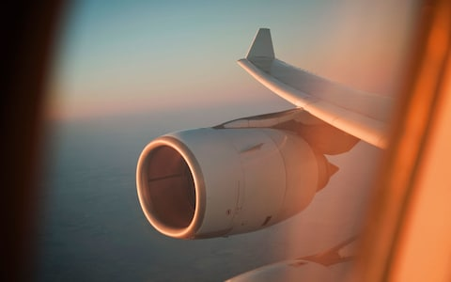
Snowball Effect
Significantly lower fuel level in right engine
Flight manual suggested crossfeed
Calculations discovering a fuel leak
Decision to divert the flight
Right engine shuts down
13 minutes later left engine cuts out

Slide 9

Bad situation
Nearest land: Lajes airport - 280 km away
Altitude: 12 000 m
Ram air turbine deploys
Passengers must wear life jackets
Oxygen masks drop down

Slide 10
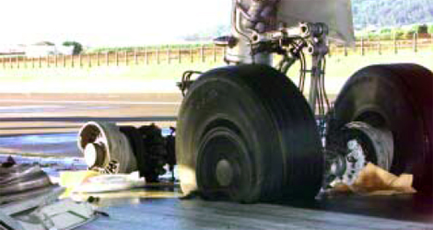
Situation Finale
Series of swirling manoeuvres
No brakes, No flops, no spoilers
Airbus hits the ground hard
Burst tires
Landing consumed 2300 meters
Disaster took no victims

Slide 11

Investigation
Aviation Accidents Prevention and Investigation Department investigated the accident along with Canadian and French authorities
Engine number 2 faulty maintenance
Replacement unit supplied with a hydraulic pump
Incompatible part from a similar model
Few millimetres of difference caused the fuel line rupture
Pilots marginalised warnings

Slide 12
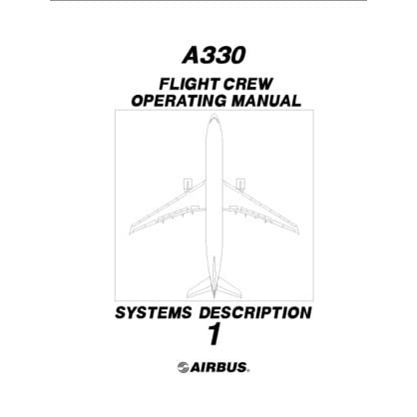
Aftermath
Flight manuals now have more procedures about fuel leaks
Air Transit cares more about pilots’ knowledge of the manual
Rolls Royce announced the incompatibility of the relevant part engines
Onboard computer have more sensors

Slide 13
Resources:
https://en.wikipedia.org/wiki/Air_Transat_Flight_236
https://www.dailymotion.com/video/x1162dc

